Slide 1
Beer Restaurant Success
By Samantha Wright, Ryan Walkley, Andrew Holt, and Hanna Kim

Slide 2
Selected Topic:
Predicting success of beer-serving businesses
Reason for selection:
Want to discern factors that lead to beer-serving business success

Slide 3
Dataset Description
Dataset: Beer_Permit_Locations.csv
Displays beer-serving business permit information [1]
Data is specific to businesses in Nashville area - i.e., Davidson County [1]
Data provided by Beer Permit Board [1]
Administrates “all laws and ordinances relating to beer and like alcoholic beverages” [3]
Obtained from Data.Nashville.gov
Publicly accessible data portal containing datasets related to various Nashville businesses, agencies, and departments[2]

Slide 4
Variables of Interest
permit_number: permit unique identifier [1]
permit_subtype: “System code for the permit subtype” [1]
date_entered: “Date the permit was entered into the system” [1]
date_issued: permit issue date [1]
business_name: “Name of the business to which the permit is issued” [1]
zip: business location zip code [1]
latitude: latitude coordinate of business location
longitude: longitude coordinate of business location
permit_duration: number of days business has held permit
Calculated by subtracting date_issued from present day date

Slide 5
Question to Answer
Based off of Beer Permit and demographic data, in which zip code will one be more successful when opening a beer serving establishment in Davidson County?

Slide 6
Data Exploration Process

Slide 7
Dataset Search and Transformation
Found and downloaded Beer_Permit_Locations.csv from Data.Nashville.gov
Imported dataset into jupyter notebook as dataframe
Pandas was used to clean and transform dataset
Columns with irrelevant data were removed
longitude and latitude column values were extracted from Mapped Locations column values
Mapped Locations column subsequently deleted
permit_duration values calculated and added as column to dataset
New, cleaned dataset exported as beer_permit_data_V1.csv

Slide 8
Database and Machine Learning Model Creation
Created RDS instance and S3 bucket in AWS
To allow data in database to be accessed by all group members
Connected pgadmin to RDS instance
Created tables to hold beer_permit_data_V1.csv data
Used jupyter notebook to fill in pgadmin tables with beer_permit_data_V1.csv data
Used jupyter notebook to create starter code for unsupervised machine learning model
Took data from database and outputted labels

Slide 9
Plan for Technologies to be Used
Data cleaning and analysis:
Pandas for cleaning and transforming data and exploratory analysis
Python for further analysis
Database storage
Postgres
Flask for data display
AWS
RDS instance for connection to pgadmin
S3 buckets
Machine Learning
Sci-kit Learn
Dashboard
Flask, Tableau, and D3.js

Slide 10
Analysis Process

Slide 11
Machine Learning Model Further Setup
Preliminary data preprocessing
Scaled beer_permit_data_V1.csv data using StandardScaler and MinMaxScaler from sklearn.preprocessing
Improves model’s numerical stability
Preliminary feature selection
Used Principal Component Analysis to to reduce the dimensionality of beer_permit_data_V1.csv
Wanted to look at amount of time a beer permit has been active to understand how long beer-serving business has been open

Slide 12
Additional Database Setup
Finished transforming beer_permit_data_V1.csv dataset
Found census data from census.gov
Cleaned and transformed using jupyter notebook
Added cleaned census dataset to postgres database
Also added it to another S3 bucket for public use

Slide 13
Dashboard Creation
Imported beer_permit_data_V1.csv dataset to Tableau
Created 4 starting visualizations
See following 4 slides
Created base plan for dashboard
Can be seen here: https://docs.google.com/presentation/d/1dch2q2eS8BSIdi2nqmHNiHonMrHwQsvSz1XJeI9PPp0/edit?usp=sharing

Slide 14
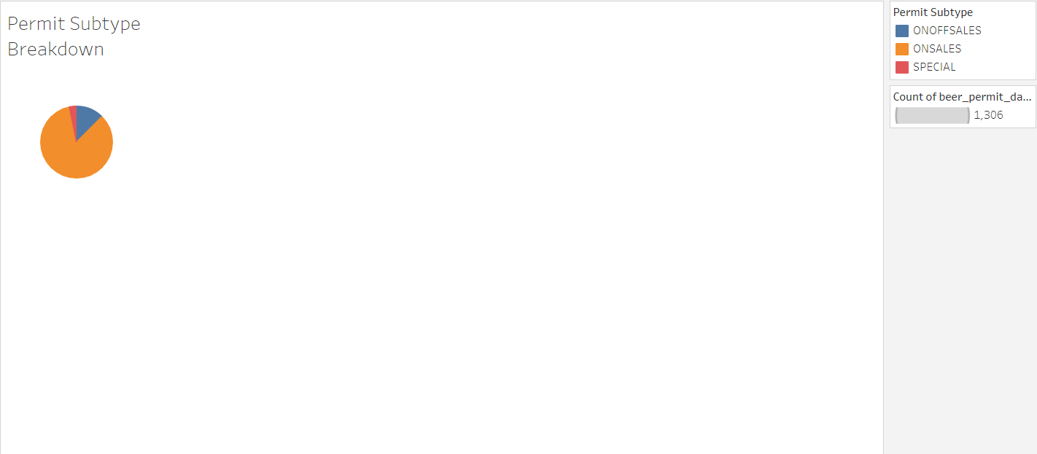

Slide 15
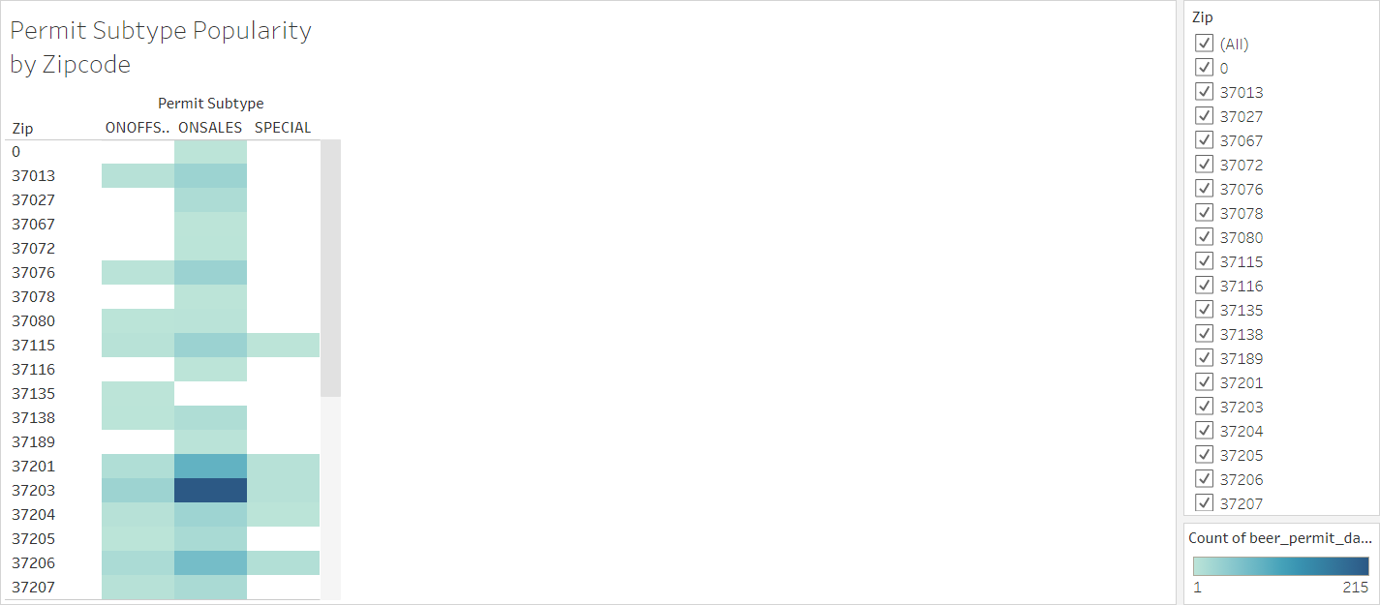

Slide 16
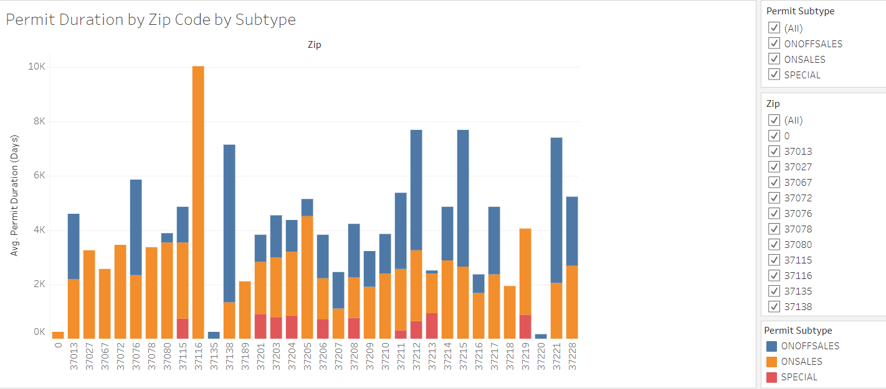

Slide 17
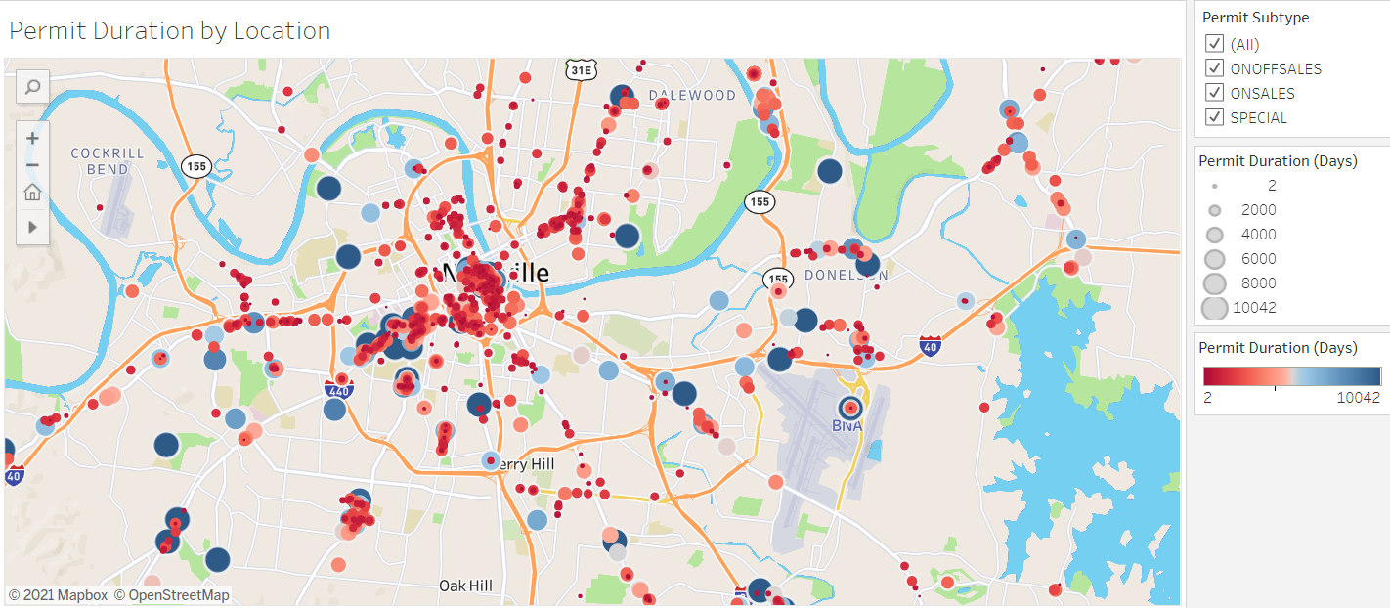

Slide 18
Sources
https://data.nashville.gov/Licenses-Permits/Beer-Permit-Locations/3wb6-xy3j
https://data.nashville.gov/
https://www.nashville.gov/Government/Boards-and-Committees/Committee-Information/ID/53/Beer-Permit-Board.aspx

